Slide 1
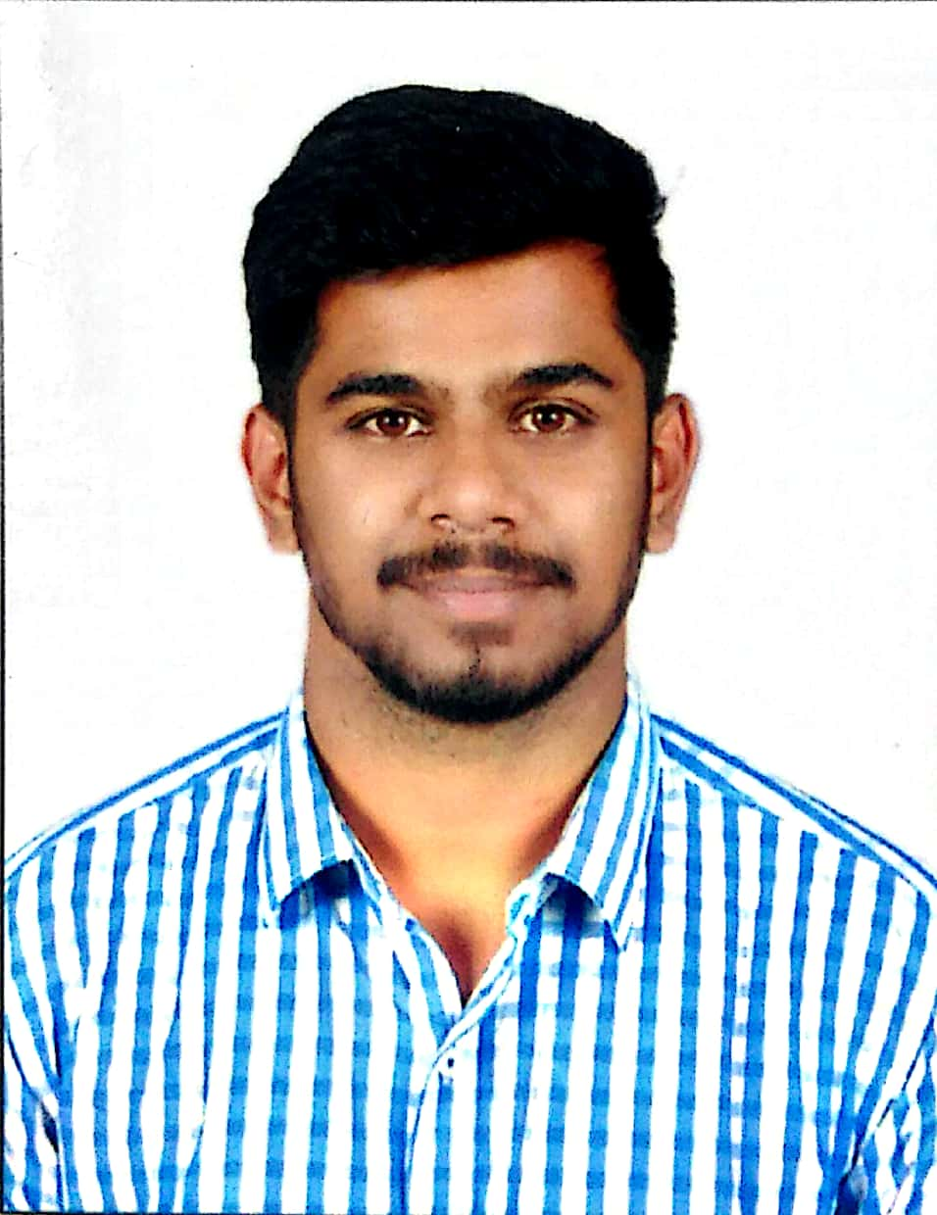
Sheshank Rao | Associate Analyst | Introduction Profile
 | Sheshank Rao Associate Analyst shesrao@deloitte.com Location: Bangalore Mobile: +91 7892137094 | Service Line – Analytics & Cognitive Competency – Artificial Intelligence and Data
 |  | ETL and Database knowledge : Informatica Power Center , Alteryx Designer , MS SQL Server , Oracle server Core Technical Expertise : Test scripts , Suites , Plans .Alteryx Designer ,Qlik Sense , Informatica Power Center , SQL Server Management Studio
Professional Experience: Sheshank is an Associate Analyst in Deloitte Consulting's Technology-> Strategy and Analytics-> Analytics and Cognitive practice . He is well versed in programming languages like C, C++,JAVA,VB and has hands on DBMS, MySQL ,Informatica Powercenter ,ETLs , visualization tools Relevant Experience: Robotic Process Automation: (Current Project) Working as a Quality Assurance in Automation(UiPath) technology – Developing test case ,test plan independently Bug reporting , Maintaining .Discussing resolution tactics with the developer Intermediate in raising service now tickets and code deployment to Production Data migration engagement: (Previous Experience) Hands-on skills and experience in Alteryx Designers like Input Data, Data Cleansing, Filter, Formula, Sort, Join Append, Union, Crosstab, Summarize, Transpose and the tools with Alteryx such as Predictive, Parsing, and different Transformations. Able to handle data migration into Alteryx and produce required insights from it. Good Proficiency level in Workflow development and maintaining the same Have also worked on similar data cleansing operations using informatica power center to derive diplomatic visualization insights for business implements . |  | Key Competencies: Database management- MS SQL Server Visualization- Qliksense , Power BI. ETL- Alteryx , Informatica Power Center . RPA – UiPath(Training) QA – Independent test scripts(Construct & testing) Academic Qualification: Bachelor’s degree in Computer Application from REVA University(Autonomous), Bangalore. Certification : Alteryx Designer Core Certified

